Slide 1
Hashing
Unit 5.3
Cybersecurity Boot Camp |

Slide 2
Warm-Up Activity: Warm-up (15 min)
In this activity, you will review of what you’ve learned so far. This includes:
Define key terms and answering questions around cryptography
Create a file and use GPG to encrypt and decrypt it.
Sign the password with a digital signature.
Answer questions around digital certificates.
Instructions
Complete the activity using the file provided to you

Slide 3
Warm-Up Activity
Instructor Review

Slide 4
Today’s Goals
By the end of class, you will be able to:
Describe hashing and hash functions
Generate hashes on the command line using the CLI tools `md5sum` and `sha256sum`
Discuss how hashing assists with forensic investigations
Crack password hashes to explore strategies for attacking hashes
Notes:
Review goals; address any questions.

Slide 5
Hashing and Data Integrity

Slide 6
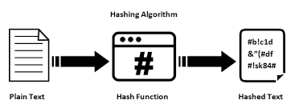
Hashing

Slide 7
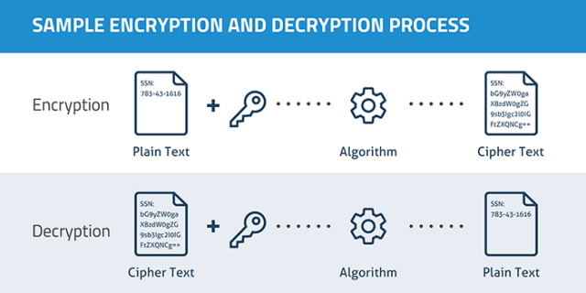
Encryption

Slide 8
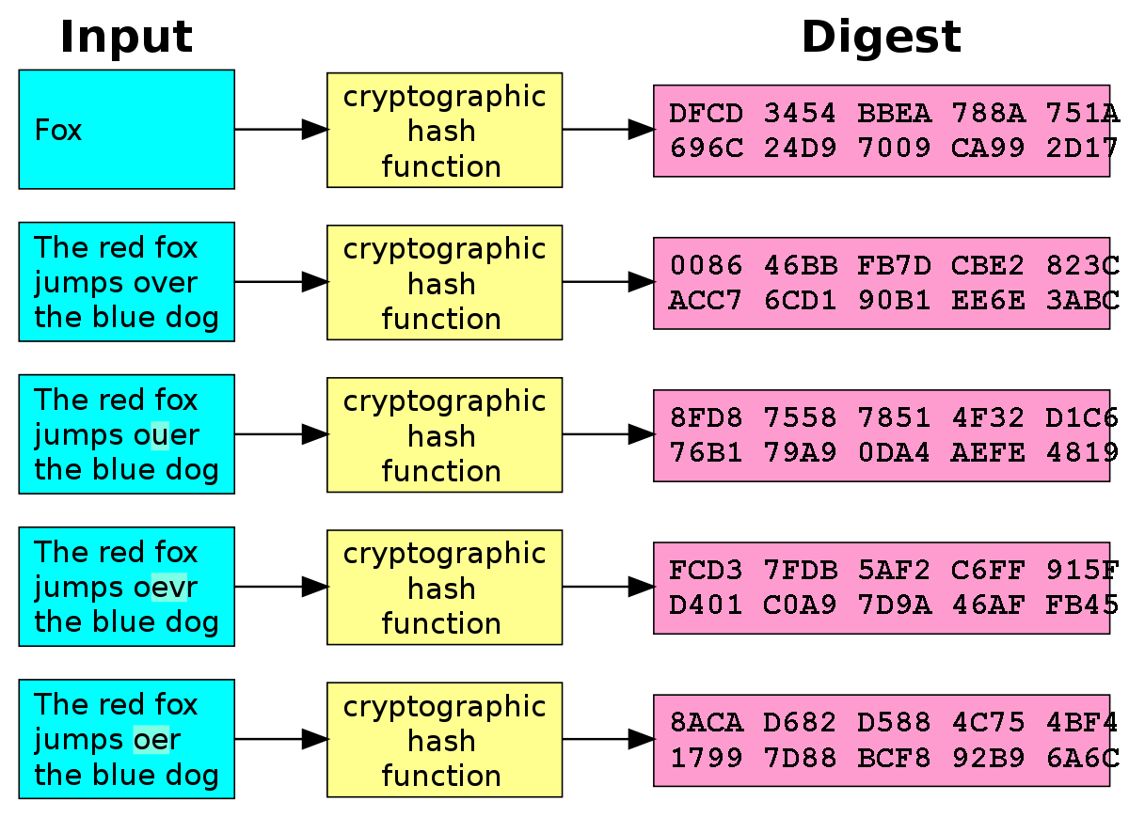
Hashing

Slide 9
Hashing
The hash of the string "example" is
ddce269a1e3d054cae349621c198dd52.

Slide 10
Hash Algorithms
MD5
SHA1 and SHA2
LM and NTLM, (used by Windows)

Slide 11
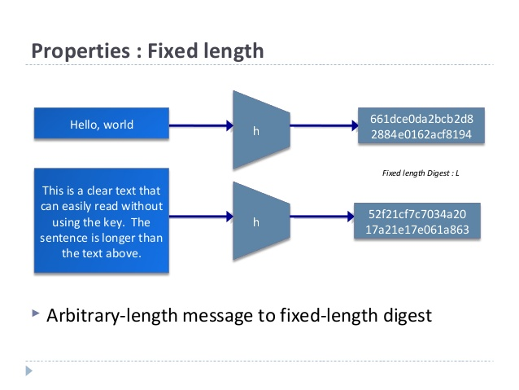
Fixed Length Output

Slide 12
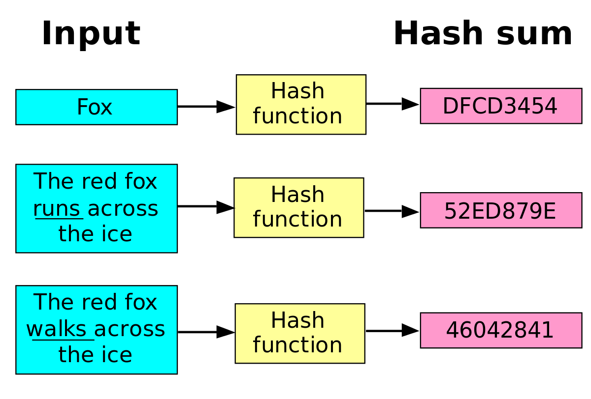
Sensitivity to Change

Slide 13
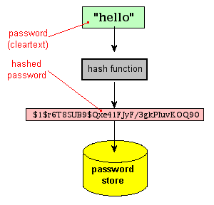
Use Case for Hashes
Hashing Website Passwords

Slide 14
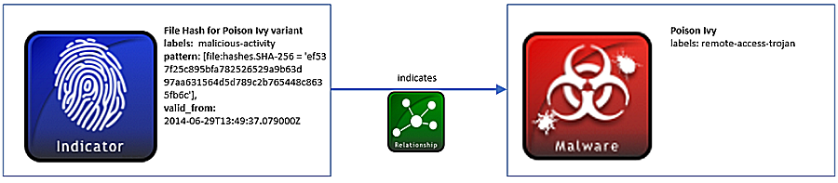
Use Case for Hashes
Fingerprinting Files

Slide 15
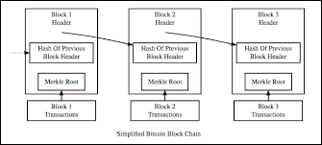
Use Case for Hashes
Verify Integrity of Cryptocurrencies

Slide 16
Today’s Goals
By the end of class, you will be able to:
Describe hashing and hash functions
Generate hashes on the command line using the CLI tools `md5sum` and `sha256sum`
Discuss how hashing assists with forensic investigations
Crack password hashes to explore strategies for attacking hashes
Notes:
Review goals; address any questions.

Slide 17
Inspecting and Generating Password Hashes (15 min)
In this activity, you will:
Use `md5sum` and `sha256sum` to generate the hash of a simple string, such as "this is an example".
Inspect the private key in id_rsa with cat.
Generate the SHA256 hash of this file, and save it to a file, called e.g. private_key_hash.
Use GPG to sign the file containing the hash with a detached signature.
Share with a partner the file containing the has, signature, and private key
Verify their partner's signature
Check the hash of the file using sha256sum
Change one of the letters in the file in the id_rsa file and try to verify the checksum
Answer questions on the activities completed
Instructions
Complete the activity using the file provided to you

Slide 18
Inspecting and Generating Password Hashes
Instructor Review

Slide 19
Today’s Goals
By the end of class, you will be able to:
Describe hashing and hash functions
Generate hashes on the command line using the CLI tools `md5sum` and `sha256sum`
Discuss how hashing assists with forensic investigations
Crack password hashes to explore strategies for attacking hashes
Notes:
Review goals; address any questions.

Slide 20
Hashes and Computer Forensics (10 min)
In this activity, you will read the following article on Hashing and Digital Forensics:
https://www.govtechworks.com/chain-of-custody-how-to-ensure-digital-evidence-stands-up-in-court/
Be prepared to discuss the following questions::
What is the Digital Chain of Custody?
How is hashing used with Digital Investigations?
How can hashing help/hurt an investigation?

Slide 21
Hashes and Computer Forensics
Instructor Review

Slide 22
Corrupted File Filter
Instructor Review

Slide 23
Today’s Goals
By the end of class, you will be able to:
Describe hashing and hash functions
Generate hashes on the command line using the CLI tools `md5sum` and `sha256sum`
Discuss how hashing assists with forensic investigations
Crack password hashes to explore strategies for attacking hashes
Notes:
Review goals; address any questions.

Slide 24
BREAK

Slide 25
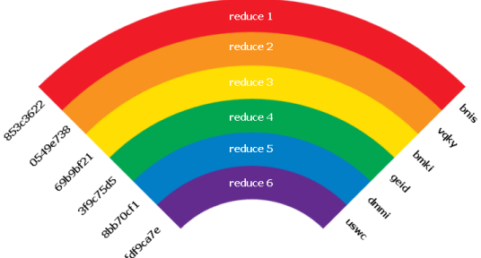
Rainbow Tables

Slide 26
Cracking Passwords with Rainbow Tables (15 min)
In this activity, you will:
Read an article about the function, purpose, and limitations of rainbow tables.
Answer questions related to the article
Instructions
Complete the activity using the file provided to you

Slide 27
Cracking Passwords with Rainbow Tables
Instructor Review

Slide 28
Hashcat (10 min)
In this activity, you will be given three files.
You will have to identify which hash each is, and then identify the correct Hashcat flags to discover the password.
Instructions
Complete the activity using the file provided to you

Slide 29
Hashcat
Instructor Review

Slide 30
Today’s Goals
By the end of class, you will be able to:
Describe hashing and hash functions
Generate hashes on the command line using the CLI tools `md5sum` and `sha256sum`
Discuss how hashing assists with forensic investigations
Crack password hashes to explore strategies for attacking hashes
Notes:
Review goals; address any questions.

Slide 31
END

